Slide 1

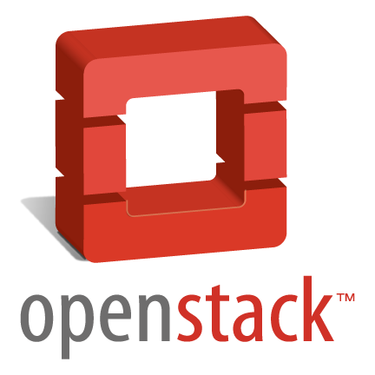
OpenStack in Sina
@程辉
freedomhui@gmail.com

Slide 2
Agenda
OpenStack Overview
Architecture Analysis
Integration Changes
Sina Contributions

Slide 3
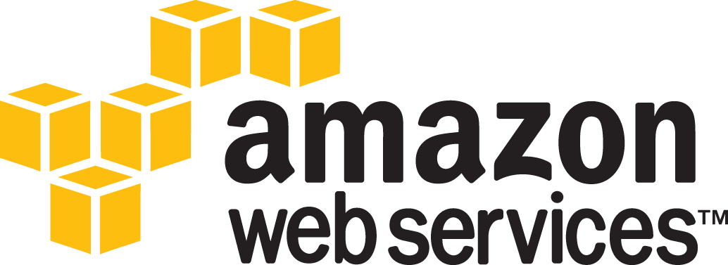

Slide 4
AWS模式的巨大成功
构建了完整的云计算生态系统
通过Web Service(API)管理一切服务*
完全面向服务架构SOA(Service-Oriented Architecture)*
事实上的IaaS 标准
成功的商业模式
*https://plus.google.com/112678702228711889851/posts/eVeouesvaVX
*http://coolshell.cn/articles/5701.html
Notes:
1) 所有团队的程序模块都要以通过Service Interface 方式将其数据与功能开放出来。（陈皓注：Service Interface也就是Web Service）
2) 团队间的程序模块的信息通信，都要通过这些接口。
3) 除此之外没有其它的通信方式。其他形式一概不允许：不能使用直接链结程序、不能直接读取其他团队的数据库、不能使用共享内存模式、不能使用别人模块的后门、等等，等等，唯一允许的通信方式只能是能过调用 Service Interface。
4) 任何技术都可以使用。比如：HTTP、Corba、Pubsub、自定义的网络协议、等等，都可以，Bezos不管这些。（陈皓注：Bezos不是微控经理吗？呵呵。）
5) 所有的Service Interface，毫无例外，都必须从骨子里到表面上设计成能对外界开放的。也就是说，团队必须做好规划与设计，以便未来把接口开放给全世界的程序员，没有任何例外。
6) 不这样的做的人会被炒鱿鱼。
7) 谢谢，祝你有个愉快的一天！
那时，如果没有被解雇的的恐惧他们一定不会去做。我是说，他们今天仍然怕被解雇，因为这基本上是那儿每天的生活，为那恐怖的海盗头子Bezos工作。不过，他们这么做的确是因为他们已经相信Service这就是正确的方向。他们对于SOA的优点和缺点没有疑问，某些缺点还很大，也不疑问。但总的来说，这是正确的，因为，SOA驱动出来的设计会产生出平台（Platform）。

Slide 5
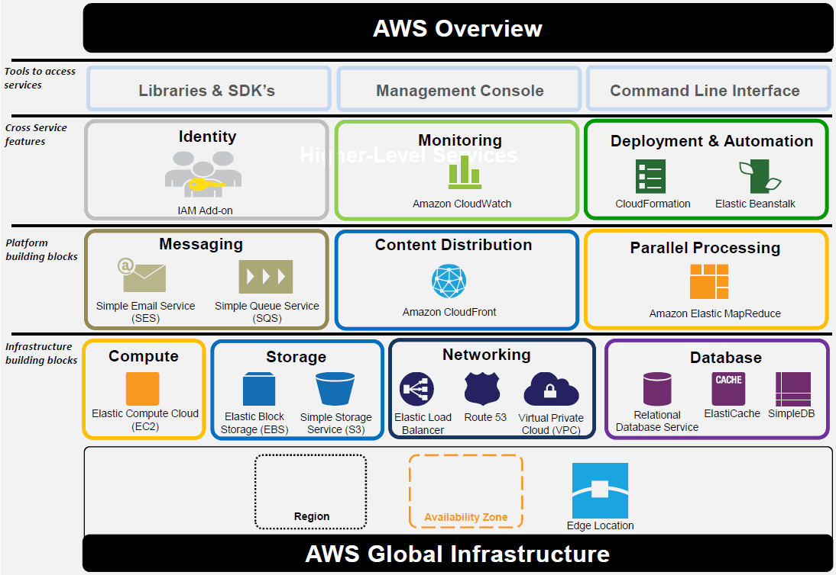

Slide 6
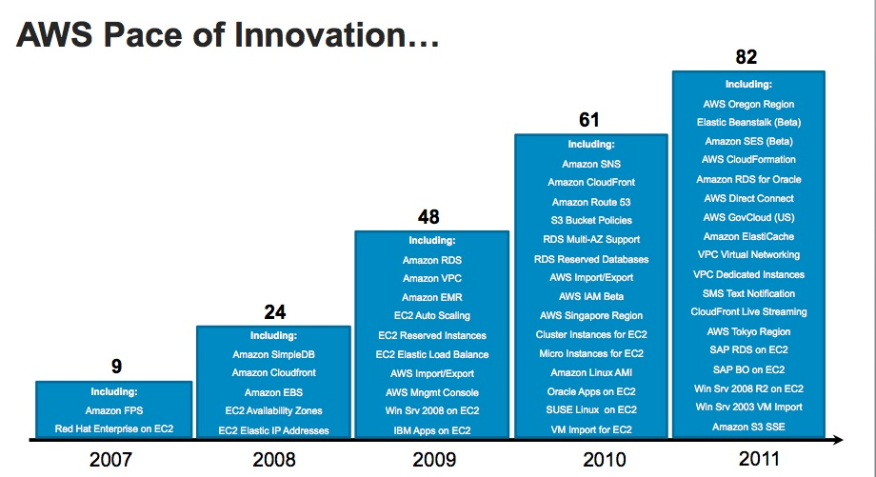
More Detail: http://aws.amazon.com/products/

Slide 7
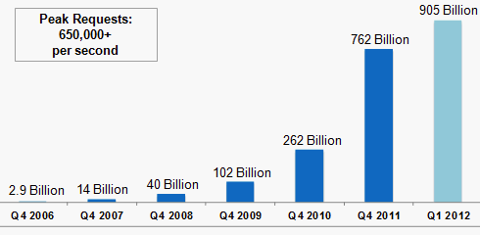

Slide 8


OpenStack横空出世
目标：AWS开源实现
Rackspace & NASA联合成立
Swift
Nova

Slide 9
























OpenStack Companies
More detail: http://www.openstack.org/community/companies/

Slide 10
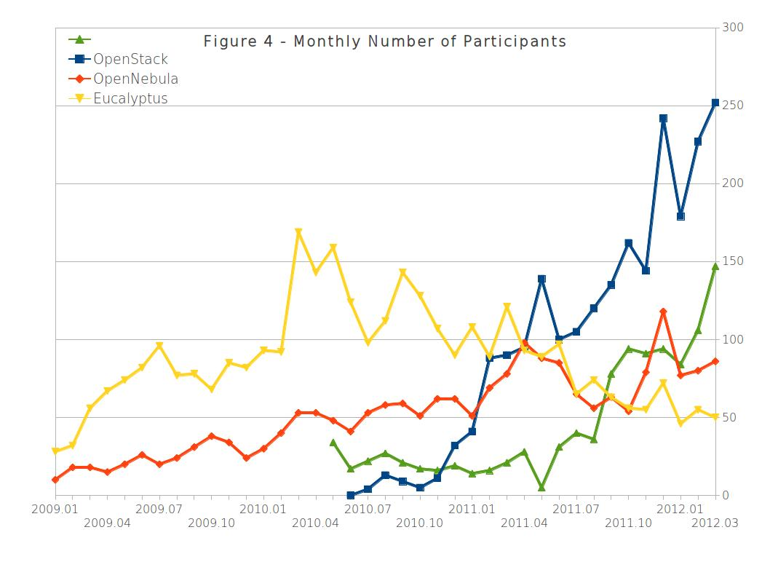
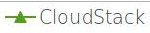
来源：《OpenStack, OpenNebula，Eucalyptus，CloudStack社区活跃度比较》http://www.qyjohn.net/?p=1856

Slide 11
Open Source
Apache 2.0 license, NO ‘enterprise’ version
Open Design
Open Design Summit
Open Development
Anyone can involve development process Open development management via Launchpad & Github
Open Community
OpenStack Foundation in 2012

Slide 12
OpenStack Mission
"To produce the ubiquitous Open Source cloud computing platform that will meet the needs of public and private cloud providers regardless of size, by being simple to implement and massively scalable."

Slide 13
OpenStack Projects
AWS | OpenStack
EC2 | nova
S3 | swift
EBS | nova-volume
ELB | Atlas-LB
SQS | Burrow
Console | Dashboard
IAM | Keystone
VPC | Quantum
RDS | RedDwarf
Core Projects
OpenStack Compute(Nova)
OpenStack Object Storage(Swift)
Image Service (Glance)
Identity (Keystone)
Dashboard (Horizon)
Network Connectivity (Quantum)
Community Projects
Melange
Altas-LB
Crowbar
Juju
RedDwarf
Burrow

Slide 14
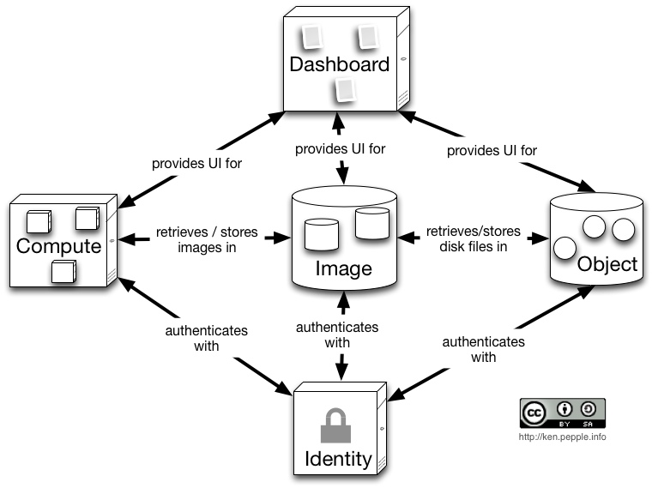
Architecture Overview

Slide 15
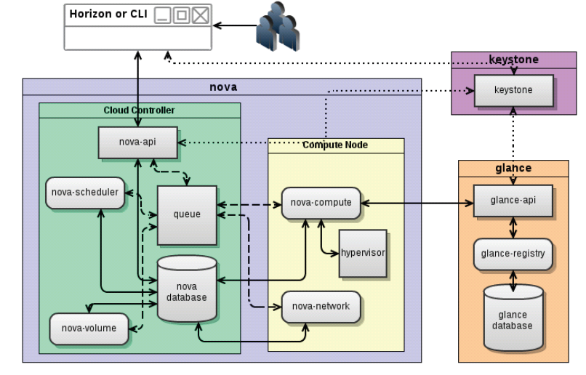
Detail Overview

Slide 16



Where to Get Started?
Ubuntu 12.04 server 集成OpenStack
Trystack.org申请测试账号
devstack.sh一键安装

Slide 17





OpenStack Development
Authorization
(group membership)
Hosting code &
formal docs
Bug tracking
Feature planning
(Blueprints)
Mailing lists
User support
(Answers)
Wiki
Informal docs
Continuous
integration

Slide 18
Nova Key Features
ReST-base API
Asynchronous communication
Horizontally scalable
Shared nothing architecture*
Distribute everything
Test everything
100% Python Based
* http://en.wikipedia.org/wiki/Shared_nothing_architecture
* http://wiki.openstack.org/BasicDesignTenets

Slide 19
OpenStack Compute: Nova
nova-api
Compute API Server
OpenStack API, EC2 compatibility API
nova-compute
Compute worker
Manage compute host and VMs
Libvirt(QEMU,KVM,LXR), XenServer and XCP, ESX(i)*
nova-network
Network controller
Manage network resources: IPAM, VLAN, NAT
*http://wiki.openstack.org/HypervisorSupportMatrix

Slide 20
OpenStack Compute: Nova(cont.)
nova-scheduler
Determines the placement of new resources
nova-volume
Block storage, remote attach a LVM volume using iSCISI protocol
Like Amazon EBS, but far way from mature
RabbitMQ
Message Queue
Cast and RPC Call for services

Slide 21
Keystone: Concept
User/Tenant
Authentication/Authorization
Token
Service/Endpoint
Role

Slide 22
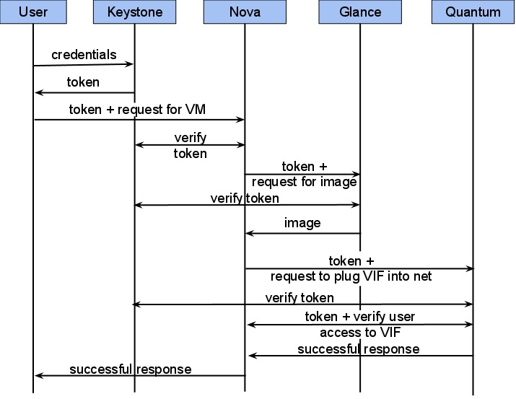
Keystone: User Case

Slide 23
Nova Network
L2
FLAT, FLATDHCP, VLAN
L3
IPAM(IP Address Management)
Fixed IP, Floating IP
Gateway, NAT, VPN

Slide 24
Quantum
Quantum Basics
Nova: virtual server
Quantum: virtual network
Quantum :
Expose a API for creating virtual networks and attaching instances(e.g.,novaservers) to those networks
Manage switches(virtual or physical) in the data center to implement connectivity described via API
Provide a“plugin” architecture to leverage support using different back-end technologies

Slide 25
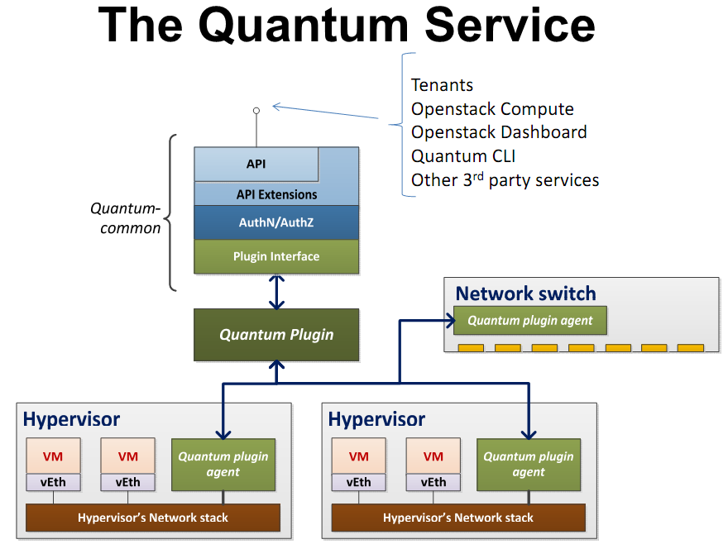

Slide 26
Quantum: available plugins
Open vSwitch
- Builds isolated networks with OVS and L2-in-L3 tunnel
Cisco UCS
- Isolation based on VLAN and net-profiles applied to Cisco UCS converged network adapters
Linux Bridge
- Build isolated networks with VLAN interfaces and linux bridges
- Works with every Linux Distro
NTT-Data Ryu
- Acts as a proxy for the NTT Ryu platform
Nicira NVP
- Acts as a proxy for the Nicira NVP platform

Slide 27
Swift: Storage Types
Types | Protocol | Application
Block Storage | SATA, SCISI, iSCISI | SAN, NAS, EBS
File Storage | Ext3/4, XFS, NTFS | PC, Servers, NFS
Object Storage | HTTP, REST | Amazon S3, Google Cloud Storage, Rackspace Cloud Files
Specific Storage | Specific protocol based on tcp | MySQL, MongoDB, HDFS
We want a Object Storage like Amazon S3.

Slide 28
Features | Swift | Amazon S3
object/bucket CRUD | √ | √
account/bucket/object ACL | √ | √
object metadate | √ | √
large object | √ | √
rate limit | √ | √
expiring object | √ | √
static web | √ | √
REST API | √ | √
Account support | √ | X
Account metadata | √ | X
Bucket metadata | √ | X
Bucket sync across cluster | √ | X
Object versioning | X | √
Log to bucket | X | √
Notification | X | √
Reduced Redundancy Storage | X | √
SOAP API | X | √
Server Side Encryption | X | √
BitTorrent protocol | X | √
Swift vs Amazon S3

Slide 29
Swift Evaluation
Extremely Durable and Highly Available
Superior Scalability
Linear Growth of Performance
Symmetric Architecture
No Single-failure
Simple & Reliable
Notes:
Enough about networking, let’s talk about storage.
We have begun testing and hacking swift when we just got to know openstack.
Swift is really a fantastic storage system, we has done kinds of thorough testing, such as destructive testing, pressure test and performance testing, our tests has proved all the features that swift official said.
At first,
Swift is extremely durable and highly available.
In one of our test cases, there are 30 million PUT requests, and we only catch 8 failed requests with http error code 503.
Superior Scalability
Swift is very easy to scale out, to increase capacity, what you have to do is no more than adding new nodes and rebalancing.
Linear Growth of Performance
New proxy node and storage node can be added to the swift cluster at any time, and how many nodes are added, you will get how many additional capacity, and the quality of service would not be affected during the scaling.
Symmetric Architecture
Symmetric architecture means that every node could be safely down and easily replaced, that tremendously ease operations.
No Single-failure
This is result of symmetric architecture.
Simple & Reliable
There is not inscrutable theory in Swift, only the quorum protocol and last-win mechanism is used.
Source code of swift is also simple, and could be easily understood.

Slide 30
Swift Components
The Ring: Mapping of names to entities (accounts,containers, objects) on disk.
Stores data based on zones, devices, partitions, and replicas
Weights can be used to balance the distribution of partitions
Used by the Proxy Server for many background processes
Proxy Server: Request routing, exposes the public API
Replication: Keep the system consistent, handle failures
Updaters: Process failed or queued updates
Auditors: Verify integrity of objects, containers, and account
Notes:
Enough about networking, let’s talk about storage.
We have begun testing and hacking swift when we just got to know openstack.
Swift is really a fantastic storage system, we has done kinds of thorough testing, such as destructive testing, pressure test and performance testing, our tests has proved all the features that swift official said.
At first,
Swift is extremely durable and highly available.
In one of our test cases, there are 30 million PUT requests, and we only catch 8 failed requests with http error code 503.
Superior Scalability
Swift is very easy to scale out, to increase capacity, what you have to do is no more than adding new nodes and rebalancing.
Linear Growth of Performance
New proxy node and storage node can be added to the swift cluster at any time, and how many nodes are added, you will get how many additional capacity, and the quality of service would not be affected during the scaling.
Symmetric Architecture
Symmetric architecture means that every node could be safely down and easily replaced, that tremendously ease operations.
No Single-failure
This is result of symmetric architecture.
Simple & Reliable
There is not inscrutable theory in Swift, only the quorum protocol and last-win mechanism is used.
Source code of swift is also simple, and could be easily understood.

Slide 31
Swift Architecture
1 Zone = 1 Physical Server with 12x2T disk
Write/Read applies quorum protocol
GET abc.png
PUT abc.png
Load Balancer
Zone1
Zone2
Zone3
Zone4
Zone5
Proxy Server
Proxy Server
Proxy Server
Proxy Server
Proxy Server
Object Server
Object Server
Object Server
Object Server
Object Server
Container Server
Container Server
Container Server
Container Server
Container Server
Account Server
Account Server
Account Server
Account Server
Account Server
Notes:
This graph demonstrates our testing deployment and two type of request, PUT and GET an object.
We have 5 physical nodes; they have identical deployment and are totally symmetrical in architecture.
Each physical server is a zone, and serves the proxy, object, container and account server, and the load balancer is in front of proxy server.
When putting an object to swift, the proxy server will simultaneous[,siməl'teiniəs] put the object into 3 nodes from different zones, and make sure that at least two nodes has been updated successfully.
And when getting the same object, the proxy server will contact the 3 nodes, which every node has one copy of the object, at least two out of 3 nodes acknowledges ok, and then proxy server randomly pick one healthy node to retrieve the object, and streaming to user.
This what so called quorum protocol.

Slide 32
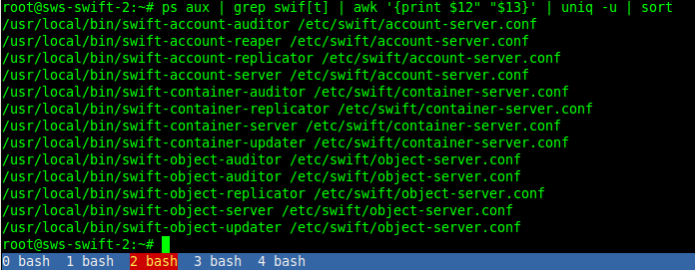
Swift Installation
Swift packages
Proxy Server
Account Server
Container Server
Object Server
Physical Deployment
Storage Nodes
OS installation
sda
sdb
sdc
sdd
sdk
raid 1
……
disk1
disk2
disk3
disk4
disk5
disk12
Notes:
Here is detail in a node, there are 12 times 2T disks, and the first two disks are configured to raid 1, used for OS and swift package installation.
And the rest 10 disk directly used by swift without raid, because the disk failure is common, does not has any impact on the availability of the storage system, each disk is a swift storage node, namely sdb, sdc ,etc.
And each server has an api server, auditor, replicator and updater.

Slide 33
Conclusion
核心功能基本可用，但稳定性需要加强
云服务(web service)比较丰富
起步虽晚，但发展飞快，OpenStack生态系统正在形成
逻辑结构清晰、文档丰富、源码规范易懂，便于二次开发
Open [Source | Desgin | Development | Community]

Slide 34
Integration Challenges
Best Network Topology
Security Enhancement
Load Balancer
CDN Services
Metering & Billing

Slide 35
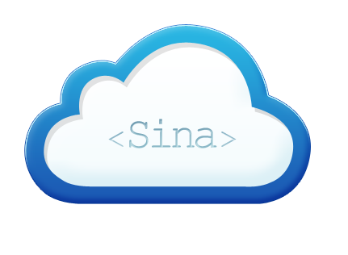
Infrastructure & Platform
Physical Servers
Traditional Operation
Virtualization Platform(IaaS)
VM Management System(VMMS) → Sina Web Service(SWS)
VMMS is private solution developed in-house
SWS is based on OpenStack
Application Platform(PaaS)
Virtual Host → Sina App Engine(SAE)
SAE provides both Public and Private Service.
Proved to be Efficient and Robust
新浪云计算
Notes:
Our Infrastructures is divided to 3 platforms, First, the majority of devices are physical servers without virtualization, and we use the traditional operations to orchestrate these servers.
There are lots of manual processes to have physical services been completely provisioned. Normally, we need 1 week to 1 month to get the physical servers being ready to use, this really wastes time and error-prone, so we have no choice but to change.
Second, Before the employment of OpenStack, we have developed our own virtualization platform targeting to build a private cloud to virtualize physical servers to manageable virtual machines.
The system dramatically decreased the delivery cycle of compute resources from several weeks to hours.
After years of operation and patching, the system was exposed some critical drawback, and need large scale refactoring to meet with business need.
And we were also looking for open source solutions as an alternative.
At this time, OpenStack came into our mind, after some testing deployment and evaluation; we found that openstack is exactly what we needed. So we have decided to use OpenStack as our IaaS solution, and launched a new project named Sina Web Service, SWS in August 2011, aiming to build a robust IaaS platform for public cloud, as well as our own business use.
And The Thrid, Let’s talk about our application platform,
We use virtual host mechanism of apache to host applications across multiple servers, and after years of development, this model evolved to a PaaS cloud computing environment, named Sina App Engine.
The app engine model has proved to be an efficient way to host applications. The developers just need to focus on their business logic, and do not need to care about any detail of underlying system and operations. The full life cycle of a product is managed by the developers or business department without intervention of operators.
Next I will take a brief introduction of SAE.

Slide 36
Nova Network
Networking is the biggest challenges for IaaS
Network Topology:
VLAN
FlatDHCP
FlatDHCP & Multihost
Notes:
Ok, let’s talk about something more technical.
In our experience, networking is the most critical for your deployment, and often determines success or failure of your business.
So I would like to talk a little more about OpenStack network in detail.
There are a log of network-related flags in nova.conf, any combination of these flags defines a network topology, in my understanding, the most important flags are nova network manager and multihost.
The network managers can be the default VLAN manager, flat manager and FlatDHCP manager.
We have tried several different network topologies, and finally find the best solution for our business.
So I will talk about 3 three network topologies defined by the two option, they are VLAN mode, FlatDHCP, and FlatDHCP plus multihost.
36

Slide 37
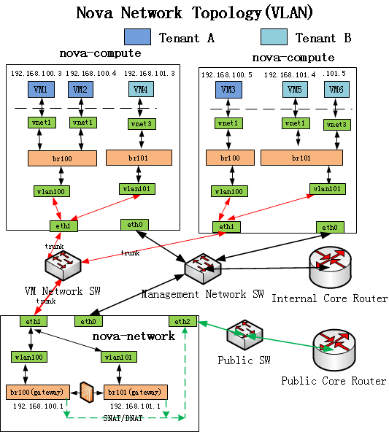
Network Topology (VLAN)
Capability:
Accessibility of VMs within one tenant
Isolation of VMs from different tenants
VM is able to access public network
VM can be accessible from public network
Isolation between virtual network and internal network
Drawback:
Pre-allocate network for future projects
Hard-limit of vlan 4096
Traffic bottleneck in the gateway/NAT
Notes:
This picture shows the physical and virtual network topology with the VLAN manager and multihost not being enabled.
Here are two compute nodes and 1 network controller, three physical switches result in three isolated networks, they are virtual network, management network and public network.
So let’s check out what capabilities the topology provides.
The first one is the Accessibility of instances within the same tenant, and isolation from different tenants. This function is the key point of VLAN network manager.
This task can be achieved by linux bridge and virtual VLAN interface.
Each tenant has a unique bridge and a VLAN id, thus different tenants are isolated by VLAN network.
Let’s check the second task, VM is able to access public network and can also be accessible from public network.
It’s an easy task, the network controller acts as a NAT server. When you want to go out, your IP packets will be SNATed, and if an instance is 1 to 1 associated a public floating IP address, then the instance will be world-addressable, the packets from the public to the floating IP will be DNATed to associated instance. The NAT is done by iptables.
The final task is to isolate virtual network from internal management network.
As you may noticed that, the VM network switch does not up link to any other router or switch, it is a standalone switch, only serving the virtual traffic between virtual machines.
So the packets from VM have no router to internal network, thus keep management network secure.
Even though VLAN manager has done a good job in isolation, and its drawback is obvious.
First, the cloud operator must manually allocate all projects and associated networks in advance, and it’s not convenient, since it is often hard to decide network size of a new tenant, and once decided, it is not possible to change in the future.
The hard limit of VLAN ID is 4096, is also an issue for bigger deployment.
The second drawback is also the most serious issue we are facing in our practice.
That is the traffic bottleneck in the network controller, where bridge gateway and NAT server is here.
Things could be worse when instances of from different regions have big data to exchange.
So after running for several months in testing environment, we finally abandoned this network topology.
Enough about VLAN manager, next I’ll talk about FLAT network.

Slide 38
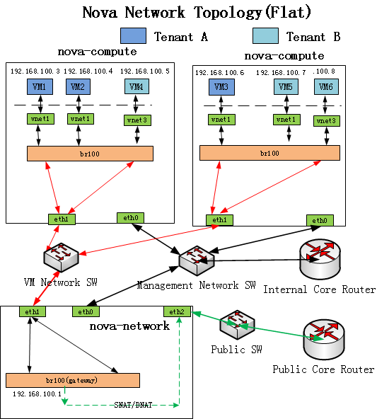
Network Topology(Flat)
Capability:
Accessibility of all VMs in the fixed IP range
VM is able to access public network
VM can be accessible from public network
Full isolation between virtual network and internal network
Bonus:
Do not need pre-allocate for new projects
Eliminating bottleneck between tenants
Drawback:
Tenant isolation has gone
Traffic bottleneck still exists in NAT
Notes:
Find the difference between vlan and flat.
It looks simpler and cleaner than vlan mode.
The vlan interfaces have gone, and only one bridge left, and thus there is only one fixed network and one gateway.
The obvious result is that the tenant isolation has gone, every instance seems belonging the same tenant, even though they have different owner in name.
So the responsibility of security is pushed to security group, and I’d like talk about more about it later.
I was hesitated to classify this feature to the class of drawbacks, because from the other hand, it could be regarded as an advantage in flat mode, because cloud operators do not need to pre-allocate a network and vlan resource, it is a big benefit when set up a public cloud computing.
Flatdhcp seems more practical but the traffic bottleneck also exists in NAT server.
Our business requires high-speed data transfer between instances and the outside network, so we also abandoned this topology.

Slide 39
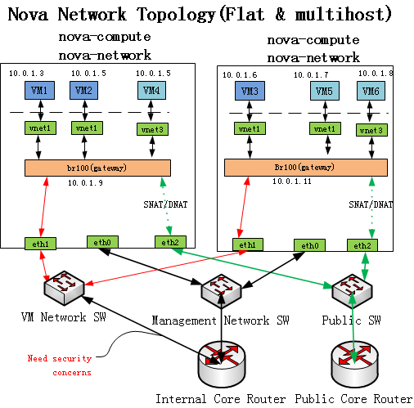
Network Topology(Flat & Multihost)
Capability:
Accessibility of all VMs in the fixed IP range
VM is able to access public network
VM can be accessible from public network
Bonus:
Totally distributed architecture avoid single-point failure.
Multiple gateway eliminates NAT bottleneck
High speed between OS regions
Drawback:
Tenant isolation lessens
Need security facility(SWS-filter) to protect intranet
If security problems were solved, this would be our best choice!
Notes:
Ok, let’s check the network topology with flatdhcp and having multihost enabled.
It is obvious that the network controller is no longer needed, instead each compute node has its own network controller.
Thus it turns out to be a totally distributed and symmetrical architecture, we will no longer worry about the network controller going down, if unluckily the compute node was down, the failure would be limited to one single node, and do not have impact on any other components.
This architecture also eliminates the NAT bottleneck, because any compute node is able to do NAT through its own public Ethernet port.
Note that the virtual machine network switch is no longer standalone, with up link to internal core router, this leads two effect:
This first is bonus, which allows the instance to do high-speed data-exchange between two different regions, this is critical for customers to do data synchronization and failure over between different region and zones. And if without this line, this could be only done by NAT through public network which is costly and slow.
The second effect is a drawback:
it gives the possibility for instances to access enterprise network. Of course, this ability needs careful restriction, or it may cause some security issues when set up a public cloud service.
So we finally choose the network topology of flatdhcp plus multihost, and now this works well in our production environment.
Next I will talk about what we have done to resolve the security issue.

Slide 40
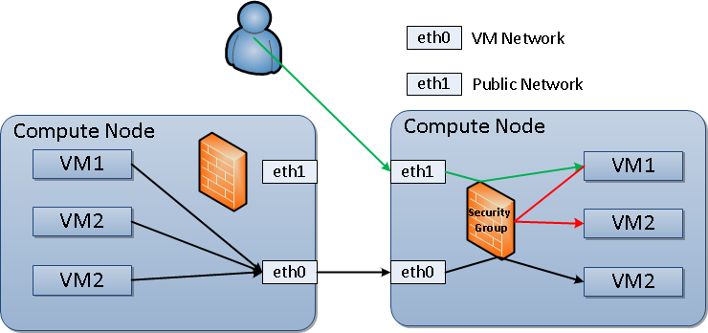
Security in OpenStack
Security Group --- L3 Filter
Role-based firewall
One security group is a Role
Ingress filtering
Target is the instance
Source can be CIDR or another group
Implemented by iptables
See details: iptables -t filter -n -L
Whitelist mechanism(ACCEPT rules)
Static filters --- L2 Filter
MAC, IP, and ARP spoofing protection
Not configurable
Defined in /etc/libvirt/nwfilter/*.xml
Implemented by ebtables
ebtables -t nat --list
Notes:
And first, I’d like to talk about the security in openstack.
There are two security mechanisms in openstack, one is the security group in layer-3 IP network, and the other is static filters, which is a layer-2 filter in Ethernet Bridge.
Security group is a firewall which resides in each compute node, which specify which incoming network traffic should be delivered to VM instances in the group, and all other incoming traffic being discarded.
It is notable that the security groups have only effects on incoming traffic, not outgoing traffic, this might be a problem when we integrating openstack to our internal network.
Look at the picture, all the incoming traffic to instance will be filtered by security group.
There are three different type of traffic path, first is that from instances in different compute node to VM3, as you can see, the packets directly goes out from eth0 bypass the firewall.
And the second is from the public network to VM1
The third is from VM1 to VM2, which are both in the same compute node.
So from this perspective, it will be secure enough as long as customers have well defined security groups.
The layer-2 filters is applied to VM when it is started, we cannot configure it, because there is no corresponding option in nova.conf, so I call it static filters.
It was used to protect the virtual network from mac, IP and ARP spoofing.
We can use this command ebtables to list whatever rules has been applied to instances.

Slide 41
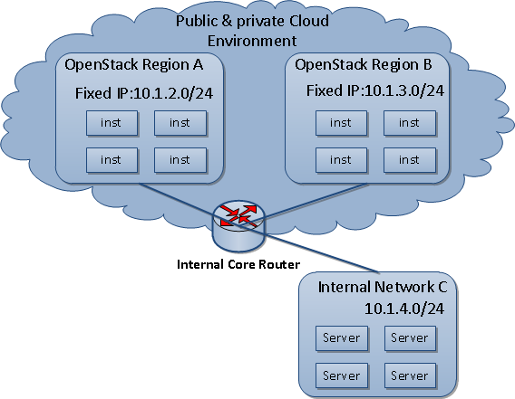
Security Enhancement
SWS Filter
Prevent Intranet Penetration
Intranet is the internal network outside of OpenStack
Egress filtering
Target is internal network
Source is instances in OpenStack
Implementation
Whitelist mechanism(ACCEPT rules)
On the top of nova-filter-top Forward Chain
Rational
SWS filter is managed by cloud manager
Only explicit authorized packets can reach Internal network C
Packet should be controlled within Compute Node
Notes:
This diagram shows the whole network of our company.
We have several openstack regions, as well as our traditional IT infrastructures.
In reality, we have two types of customers, one is the public users, who should be isolated from our enterprise network, and the other is internal customers, who need to exchange data with internal network.
From my perspective, I want to put them together into the same environment, avoid maintaining two heterogeneous platforms.
But how do we reconcile the conflict?
I have just told that security group are used to filter incoming traffic, not outgoing traffic, so if we provide public cloud service, the unauthorized network traffic could go to any corner of our enterprise network. it is really a big security threat.
In addition to security group, we have implemented another security mechanism, named SWS Filter, actually it is just like security group, but used to filter outgoing traffic from instances.
SWS filter is designed to define which instance in openstack environment have access to which IP in enterprise network.
SWS filter is managed by cloud manager, not ordinary users or project manager.
By default, SWS filter drops all network traffic from instances to enterprise network, that is to say, the traffic from A to C or B to C is dropped unless additional authorization from cloud manager.
When the traffic goes out of compute node, it will be free to go anywhere. That is why we implement SWS filter in compute node as iptables rules like security group.
Until now, we finally put private and public business together safely into the same openstack environment.

Slide 42
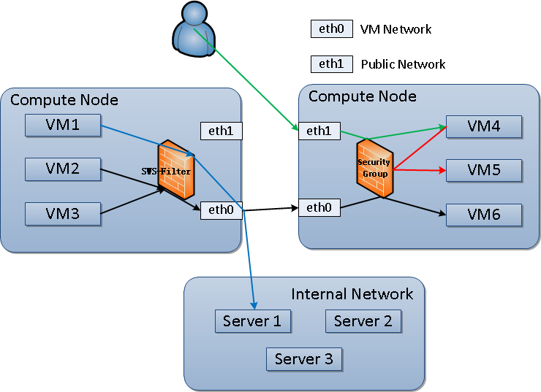
Security Enhancement
Security Group VS SWS Filter
Notes:
This is a clear picture to demonstrate the difference of Security Group and SWS filter.
Now, when the virtual firewall is used to filter incoming traffic, it is called security group,
And when it is used to filter outgoing traffic, it will be SWS Filter.

Slide 43
Load Balancer
Goals
Load Balance
Dispatch request
Support multiple routing algorithm
Health check
Acceleration
Reality: narrow bandwidth between ISPs
Building fiber channels from ISPs to pivot
Given the same endpoint within user’s ISP
IPv4 Shortage
Reality: dozens of public IPs support hundreds of VMs
IPv4 has been exhausted
IPv6 is not realistic yet in China
DNS Acceleration Design
Smart DNS
Public Network
Telecom
Unicom
Mobile
Others ISP
High speed fiber channel
Pivot
Notes:
Load balancer is a requirement to provide services to the public, because of the particular network environment in China.
We have three goals to design load balancer:
The first is load balancing, it is easy to understand, just receiving request, and dispatching request according to a particular routing algorithm, and pick off the dead backend.
Health check is used to detect whether the backend is alive or dead.
The second target is to speed up user’s connection to our servers.
In US, this is often the responsibility of internet providers, but in China, we have to solve the problem by ourselves.
So we take our office as pivot, building high speed fiber channels from our office to data centers within different internet providers.
So any two data centers will have high speed connection to each other through the pivot no matter which ISP they belongs.
To accelerate uses’ speed, the last thing is make sure users always be given the same endpoint with users’, this is done by smart DNS system.
The last goal of load balancer is to relieve IPv4 Shortage.
The ipv4 shortage is a global problem, but it seems more serious in China, we are often offered few IPv4 addresses to provision hundreds of servers.
We have no choice but to share IPv4 resources.
With load balancer, we can easily share IP address with a lot of customers.
Next I will talk about the implementation of load balancer service.

Slide 44
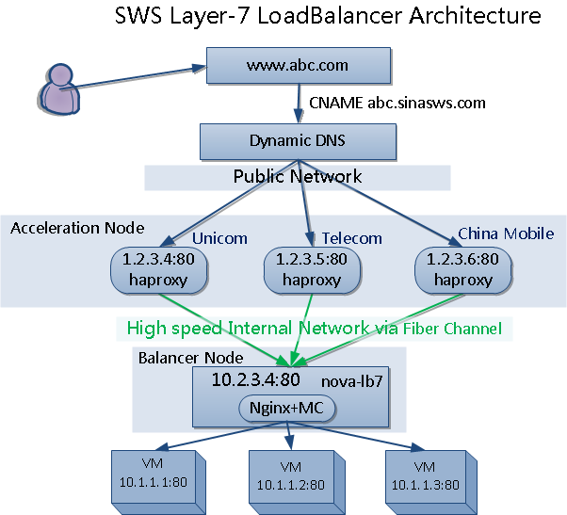
L7 Load Balancer
Layer 7 Load Balancer
Consideration:
1. dispatch request by Host header
2. nginx module
Notes:
Our load balancer service has two types: layer-7 for HTTP protocol, and layer-4 for TCP protocol.
This diagram describes the architecture of layer-7 load balancer.
For example, our customer has deployed a website with three backends, his domain is www.abc.com, which have a CNAME record to abc.sinasws.com, which is a dynamic domain,
It will return different IP address according to the client’s location and ISP,
So user from China Telecom will be always given a IP address belonging to China Telecom, thus, user will have a high speed connection to the server.
It is worth noting that, the node with haproxy running, we call it acceleration node, is a transparent proxy to our real load balancer node, which is a nginx server.
We choose nginx as balancer node because of its high performance and extensibility.
Multiple customers share the same nginx server with their configuration being saved in a memcache instead of plain text file, we wrote a nginx module to get routing infomation from memcache when request arriving. So when updating nginx configuration, it do not need to reload the nginx process.
How does the nginx pick backends for one request ?
The answer is By Host header.
Host header is extracted from http request, and the memcache has a mapping of hostname to backends, so the nginx just query the backends for the request.
Because the hostname of websites are different, so multiple apps are able to share the same IP.
The nova-lb7 is a worker of load balancer service, who is responsible for adding/ deleting/ updating load balancer’s configuration in the memcache.

Slide 45
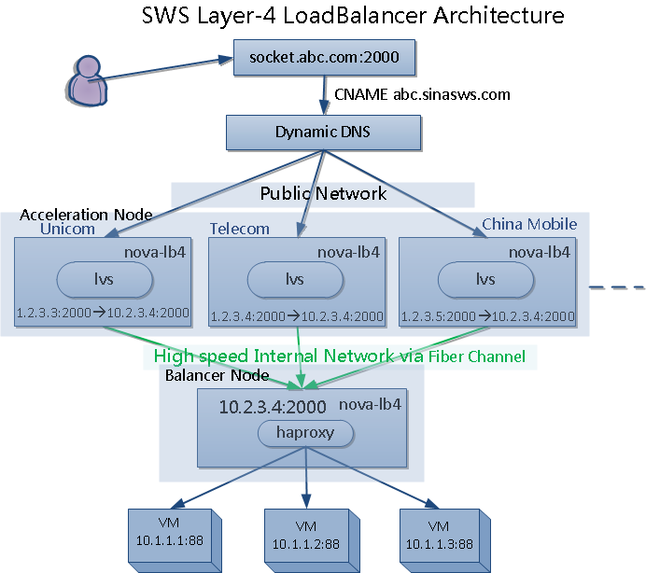
L4 Load Balancer
Layer 4 Load Balancer
Consideration:
1. dispatch request by TCP port
2. lvs + haproxy
ssh –p 2000 root@socket.abc.com
Notes:
The layer 4 load balancer is a little bit more complex, it is often used by web socket in web games, and can be used by other purpose, such as ssh login.
What we can identify the TCP connection in layer 4 is IP address and port number, which are the basic elements of TCP protocol.
The IP address is rare, but One IP address can be assigned over sixty thousand port numbers, so we can use the port number to decide which backend the requests should be sent to.
so in theory, with only one IP address, we can create as much load balancers as port numbers.
Unlike the layer-7 load balancer, whose acceleration node does not has logic of load balancer, just forward any request to the fixed balancer nodes who is doing the real work of load balancing.
The acceleration nodes in layer-4 load balancer are using LVS to DNAT the public ip address to internal ip of balancer node with particular port number, then the balancer node dispatch request to appropriate backends according the mapping of port number to backends.
So in this diagram, TCP request to socket.abc.com with port number 2000 will be finally redirected to port 88 of the three backends’.
If there are only one backend, the load balancer will be used to ssh login or to access any other service that listened on TCP port, for example, if the port 2001 was mapped to port 22 of this instance, then we can use ssh command ( ssh –p 2001 root@socket.abc.com ) to login the backend.
Yes, you do not need extra public IP, one TCP port is enough.

Slide 46
Kanyun: Monitoring system
Compute
Network
Storage
Worker
RDBMS
Dashboard
Worker
Retrieve usage info
Billing
API daemon
Aggregator
Responds to client request
Calculates/stores metrics
http://github.com/lzyeval/kanyun
NoSQL

Slide 47
Dough:Billing system
RPC
Database
Client
Compute
Network
Storage
RDBMS
Dashboard
Collector
Monitoring
(Metering)
Farmer
API daemon
Collector
Dispatch jobs
Subscribe or
unsubscribe
products /
Query info
Check status /
Retrieve usage /
Create purchases
http://github.com/lzyeval/dough

Slide 48
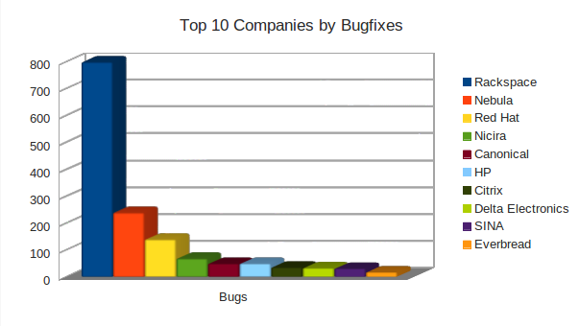
Sina Contributions
Top 10 Bugfix Company
48
Notes:
Ok, let’s talk about something more technical.
In our experience, networking is the most critical for your deployment, and often determines success or failure of your business.
So I would like to talk a little more about OpenStack network in detail.
There are a log of network-related flags in nova.conf, any combination of these flags defines a network topology, in my understanding, the most important flags are nova network manager and multihost.
The network managers can be the default VLAN manager, flat manager and FlatDHCP manager.
We have tried several different network topologies, and finally find the best solution for our business.
So I will talk about 3 three network topologies defined by the two option, they are VLAN mode, FlatDHCP, and FlatDHCP plus multihost.
48

Slide 49
Sina Contributions
Sina creating open source project “Dough” to contribute metering & billing capability
Present in OpenStack Design Summit & Conference
OpenStack APEC Conference Promoter
49
Notes:
Ok, let’s talk about something more technical.
In our experience, networking is the most critical for your deployment, and often determines success or failure of your business.
So I would like to talk a little more about OpenStack network in detail.
There are a log of network-related flags in nova.conf, any combination of these flags defines a network topology, in my understanding, the most important flags are nova network manager and multihost.
The network managers can be the default VLAN manager, flat manager and FlatDHCP manager.
We have tried several different network topologies, and finally find the best solution for our business.
So I will talk about 3 three network topologies defined by the two option, they are VLAN mode, FlatDHCP, and FlatDHCP plus multihost.
49

Slide 50

Q & A
@程辉
Technical Manager @ Sina
手机：***
邮箱：chenghui@staff.sina.com.cn
Gtalk: freedomhui@gmail.com

